Slide 1
GANs
BY : AHMED HAYTHAM

Slide 2
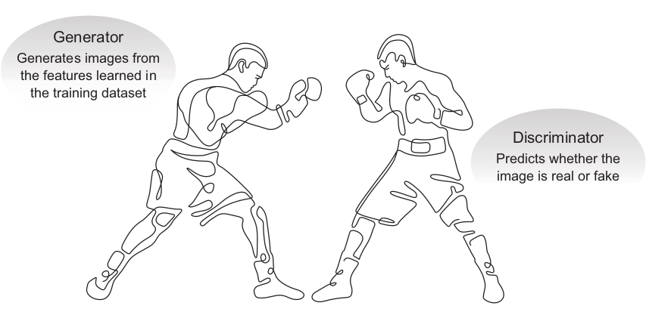
GANs
Generative adversarial networks (GANs) are a new type of neural architecture introduced by Ian Goodfellow and other researchers at the University of Montreal, including Yoshua Bengio, in 2014.1
the most interesting idea in the last 10 years in ML
GAN architecture
GANs are based on the idea of adversarial training
The generator tries to convert random noise into observations that look as if they have been sampled from the original dataset.
The discriminator tries to predict whether an observation comes from the original dataset or is one of the generator’s forgeries.

Slide 3
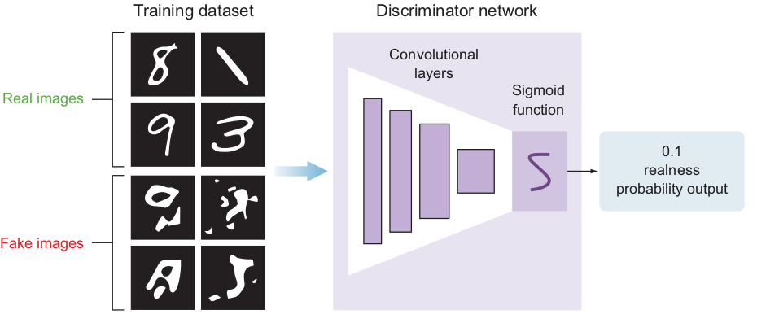
Deep convolutional GANs (DCGANs)
The discriminator model
the goal of the discriminator is to predict whether an image is real or fake. This is a typical supervised classification problem

Slide 4
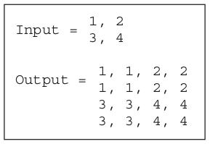
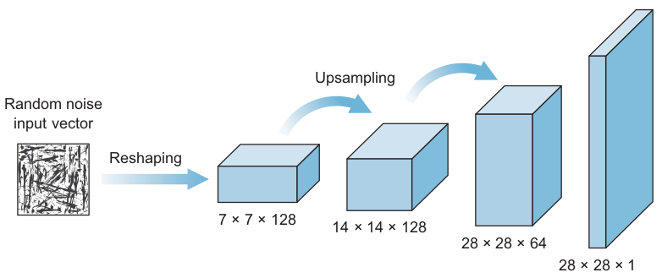
Deep convolutional GANs (DCGANs)
The generator model
The generator takes in some random data and tries to mimic the training dataset to generate fake images. Its goal is to trick the discriminator by trying to generate images that are perfect replicas of the training dataset
UPSAMPLING TO SCALE FEATURE MAPS

Slide 5
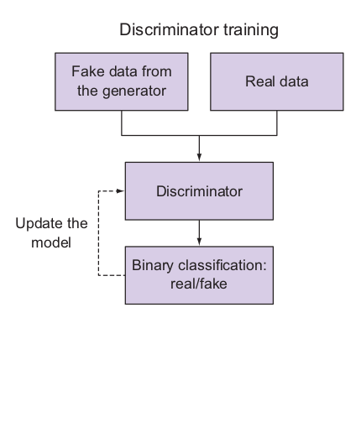
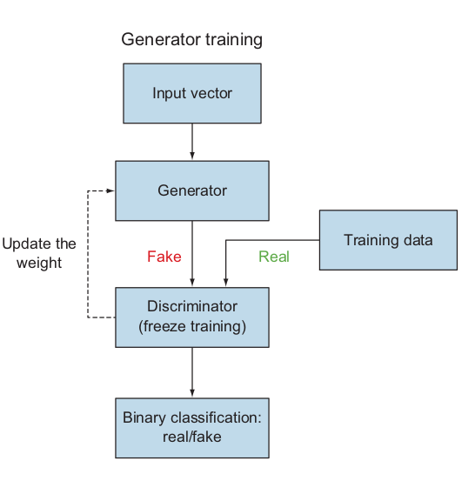
Training the GAN
Now that we’ve learned the discriminator and generator models separately, let’s put them together to train an end-to-end generative adversarial network.
Train the discriminator. This is a straightforward supervised training process. The network is given labeled images coming from the generator (fake) and the training data (real), and it learns to classify between real and fake images with a sigmoid prediction output. Nothing new here.
Train the generator. This process is a little tricky. The generator model cannot be trained alone like the discriminator. It needs the discriminator model to tell it whether it did a good job of faking images. So, we create a combined network to train the generator, composed of both discriminator and generator models.

Slide 6
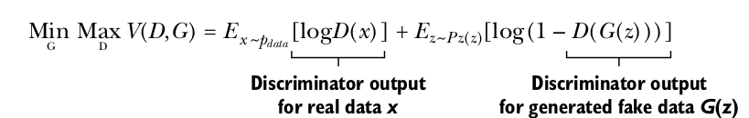
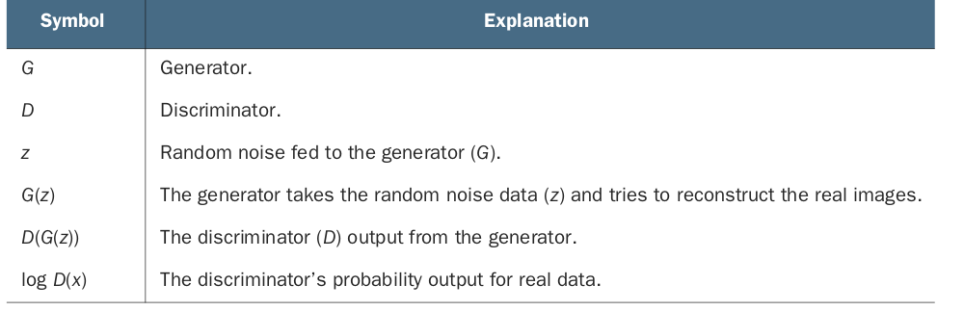
GAN minimax function
GAN training is more of a zero-sum game than an optimization problem. In zero-sum games

Slide 7
Evaluating GAN models
The models must be evaluated using the quality of the generated synthetic images and by manually inspecting the generated images.
Manual VS Auto

Slide 8
Inception score
Fréchet inception distance (FID)
High predictability of the generated image—We apply a pretrained inception classifier model to every generated image and get its softmax prediction. If the generated image is good enough, then it should give us a high predictability score.
Diverse generated samples—No classes should dominate the distribution of the generated images.
The FID score was proposed and used by Martin Heusel et al. in 2017.4 The score was proposed as an improvement over the existing inception score.
Like the inception score, the FID score uses the Inception model to capture specific features of an input image.

Slide 9
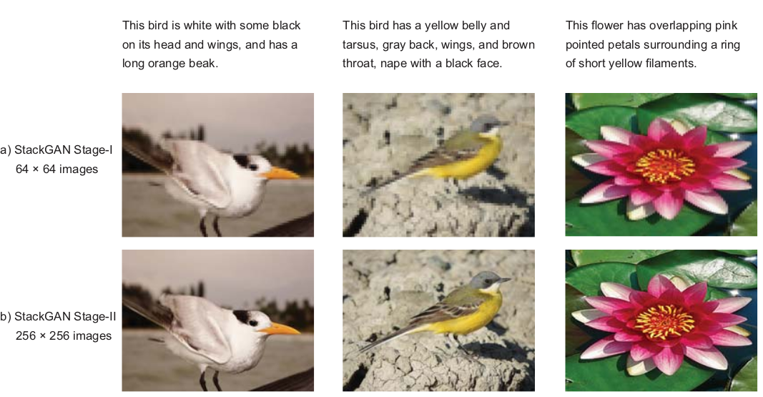
Popular GAN applications
Text-to-photo synthesis

Slide 10
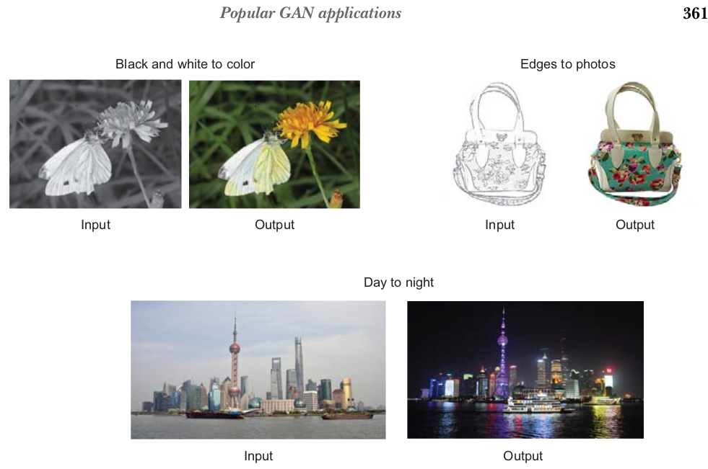
Popular GAN applications
Image-to-image translation (Pix2Pix GAN)

Slide 11
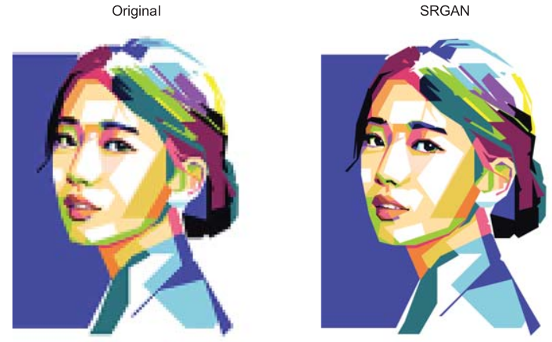
Popular GAN applications
Image super-resolution GAN (SRGAN)

Slide 12
Thank
You

